Slide 1

HEALTHCARE REVIEW SENTIMENT ANALYSIS
PRESENTED BY SAILEE PRASHANT ALLYADWAR

Slide 2

Objective
To extract insights from healthcare reviews and classify them into sentiment categories—positive, neutral, and negative.

Slide 3



Source: Patient reviews with ratings
Dataset Overview
Features:
Review Text
Rating (1 to 5)
Features Available:
Review Text – Written feedback from patients
Rating – Numerical score from 1 to 5
Important Note:
No direct sentiment label provided
Sentiment had to be derived from the rating
Goal: Convert ratings into sentiment labels for supervised learning
Target: Sentiment (Negative, Neutral, Positive)

Slide 4
Data Preprocessing
Sentiment Mapping
Removed rows with null review texts
Cleaned text:
Removed special characters using regex
Converted to lowercase
Tokenized sentences
Removed stopwords using NLTK
Ratings 1 & 2 → Negative
Rating 3 → Neutral
Ratings 4 & 5 → Positive
Labels used for supervised learning
Dataset lacks explicit sentiment categories
only numerical ratings are available

Slide 5


Text Analysis and Feature Extraction
Generated Word Cloud and Bar Plots
Identified common words in positive/negative reviews
Observed emotional keywords like "helpful", "worst", etc.
Applied TF-IDF Vectorization (unigrams and bigrams)
Converted text data into numerical features for training

Slide 6
Model Training
To train the sentiment classification model, a machine learning pipeline was built combining TF-IDF vectorization and a Multinomial Naive Bayes classifier. The pipeline first transformed the preprocessed review texts into numerical feature vectors using TF-IDF, capturing the importance of words and phrases (including unigrams and bigrams). This was followed by training a Naive Bayes model, which is well-suited for text classification problems. To optimize the model's performance, GridSearchCV was applied, testing various combinations of hyperparameters like smoothing factor (alpha) and term frequency thresholds. The model was evaluated using 5-fold cross-validation, ensuring that the results were reliable and not overfitted to a single data split.

Slide 7
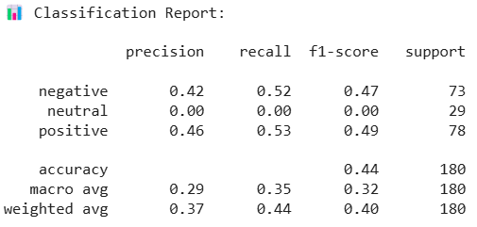
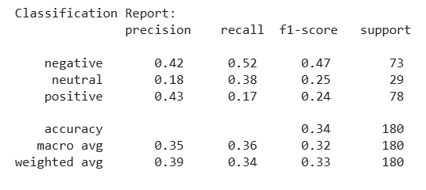
Evaluation Metrics
Accuracy and Confusion Matrix used for evaluation.
Naive Bayes performed best among models.
Neural network struggled with precision for minority class.
For both with class imbalance and without class imbalance after applying SMOTE

Slide 8
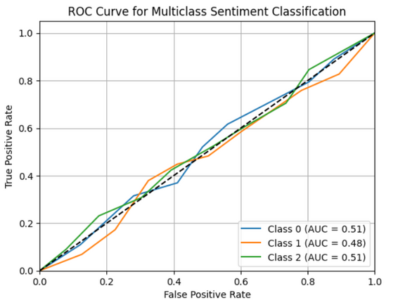
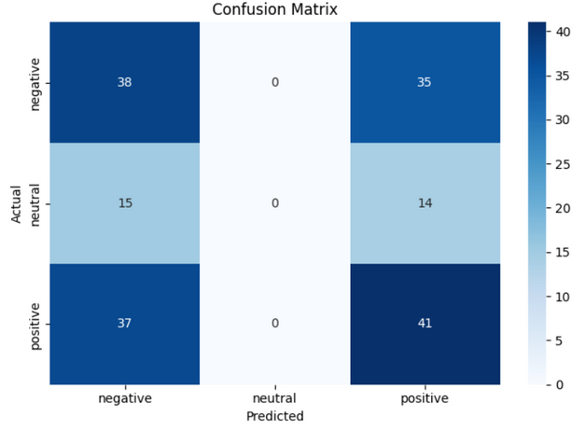
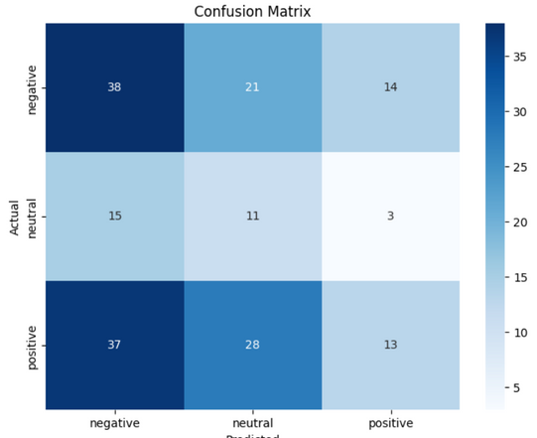
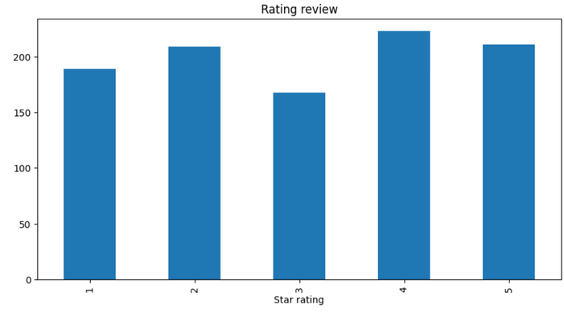
Exploratory Data Analysis
Word Clouds show common words in each sentiment.
Bar Charts display review distributions.
Majority of reviews are positive.

Slide 9
Thank you very much!
PRESENTED BY SAILEE PRASHANT ALLYADWAR

